Slide 1
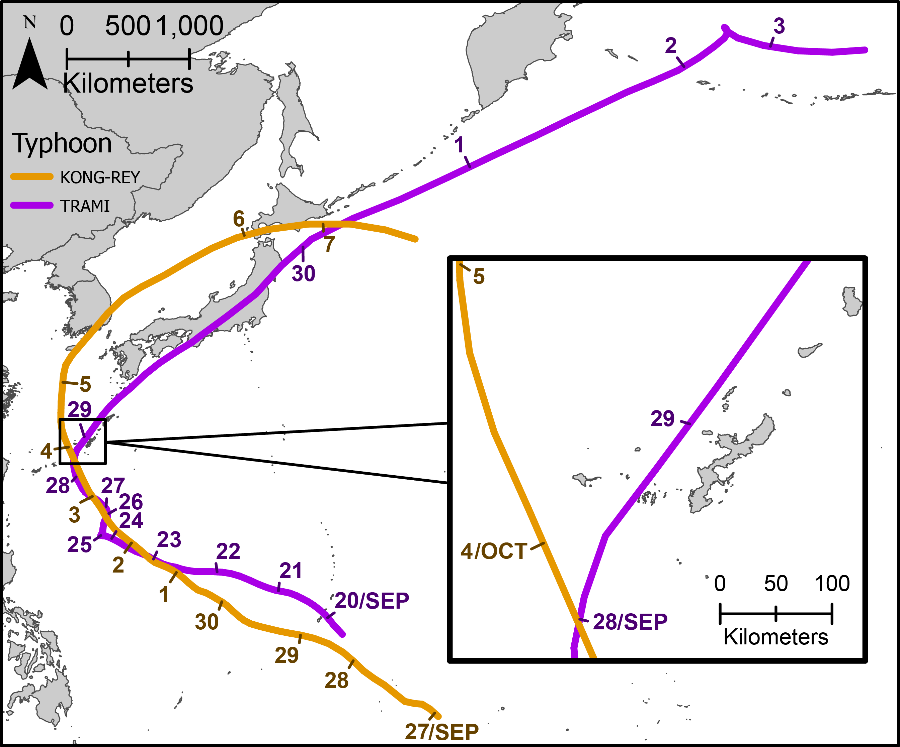
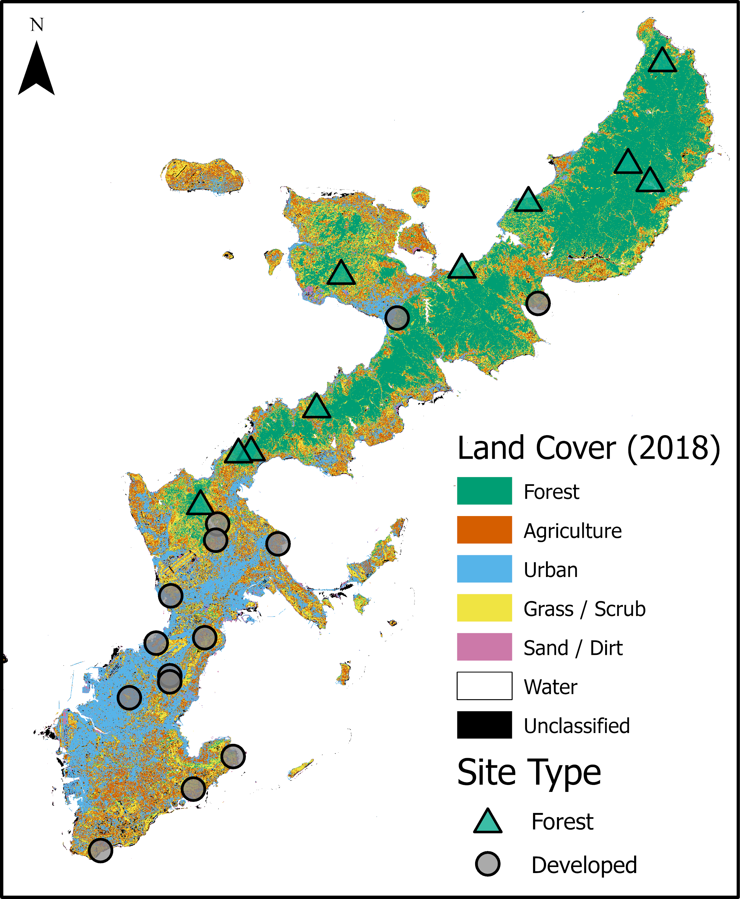
02
03
Land Cover (2018)
Typhoon
Site Category
(a)
01
Forest
Sand/Dirt
Trami
Forest
Agriculture
Water
Kong-Rey
Developed
06
07
Urban
Unclassified
30
05
Scrub/Grassland
05
Trami
Kong-Rey
29
29
04
27
28
26
03
24
(c)
25
02
23
22
21
Oct 04
01
30
Sep 20
Sep 28
M
29
28
Sep 27
(b)
(d)
NDSI
Chatan

